Slide 1
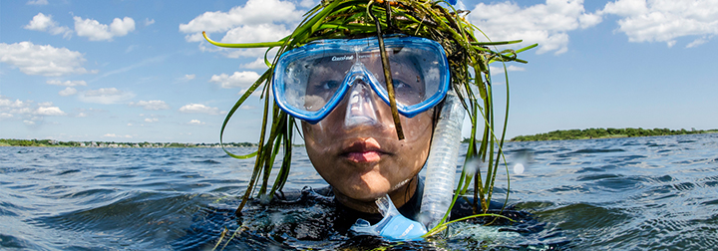
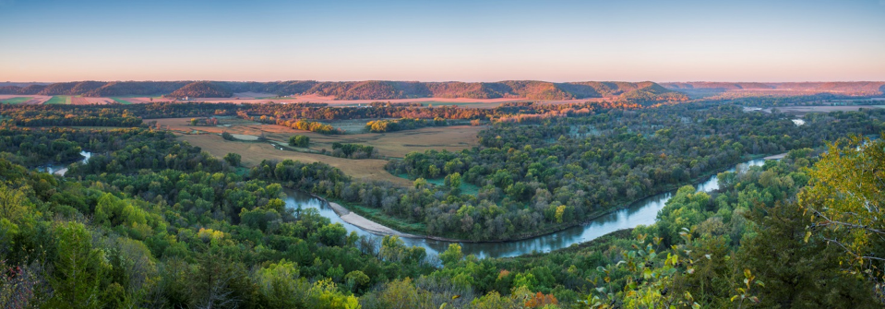
The Nature Conservancy
Freshwater Blueprint
Rich Biske – Freshwater Program Director
© NICK HALL

Slide 2
The mission of The Nature Conservancy is to conserve the lands and waters on which all life depends.

Slide 3
Our Priorities
Protect Land and Water
Provide Food and Water Sustainably
Tackle Climate Change

Slide 4
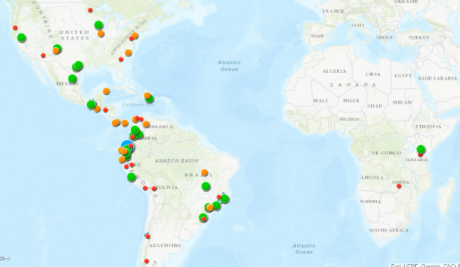
Conservancy Water Funds
Notes:
The Conservancy has been active in freshwater Conservation here in MN and around the world. We’ve set up water funds that are outcome based to achieve not just water quality goals and outcomes, but drinking water supply

Slide 5

$10 million privately funded investment to accomplish high-impact conservation in water supply source areas of the Mississippi River
Actions
Implement targeted conservation in watersheds
Raise awareness of water quality issues affecting cities
Leverage public resources for conservation
Enable private sector to be part of the solution
Spur long-term investment by water users
Notes:
The Conservancy has found that we need to spend more of our privately raised funds to help direct watershed programs and initiatives. The state water programs and Clean Water Funds have been slow and difficult to change. While we’ve made progress with our local partnerships and some modest progress with the Clean Water Council, we have found the agencies have been slow to adopt an outcome based approach that focuses on implementation where it can have the greatest impact.
We’ve started to do this for our protection work in the northern part of the basin.
We are now working with some farms, retailers and partners in the Sauk River near St. Cloud, offering incentives to landowners and coops for nutrient management and soil health practices based on what is economical for them.

Slide 6
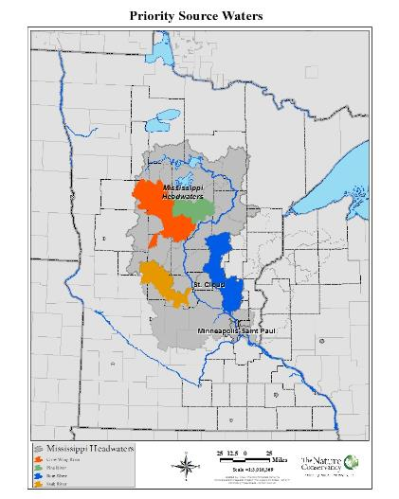
Our goal is to protect and restore priority watersheds for the benefit of people & nature.
Protect and restore the lands most critical for watershed health and multiple benefits.
Reduce nitrogen by 20%
Reduce phosphorus by 20%
Maintain flows on the upper Mississippi River within 10% of long-term historical mean flows
Maintain low flow for drinking water supply in Minneapolis at the water treatment plant
(7-day low flow not less than 1000 cfs)
Notes:
Improve watershed resiliency to projected future land and climate change.
Increase the ecosystem function of stream and wetland restoration projects to maximize the project benefit downstream.
Increase water storage through wetland restoration, soil health improvements and other practices to prevent or mitigate increases in stream flow.
Reduce threats to the 5 healthy watershed components – hydrology, biology, geomorphology, water quality, and connectivity.

Slide 7
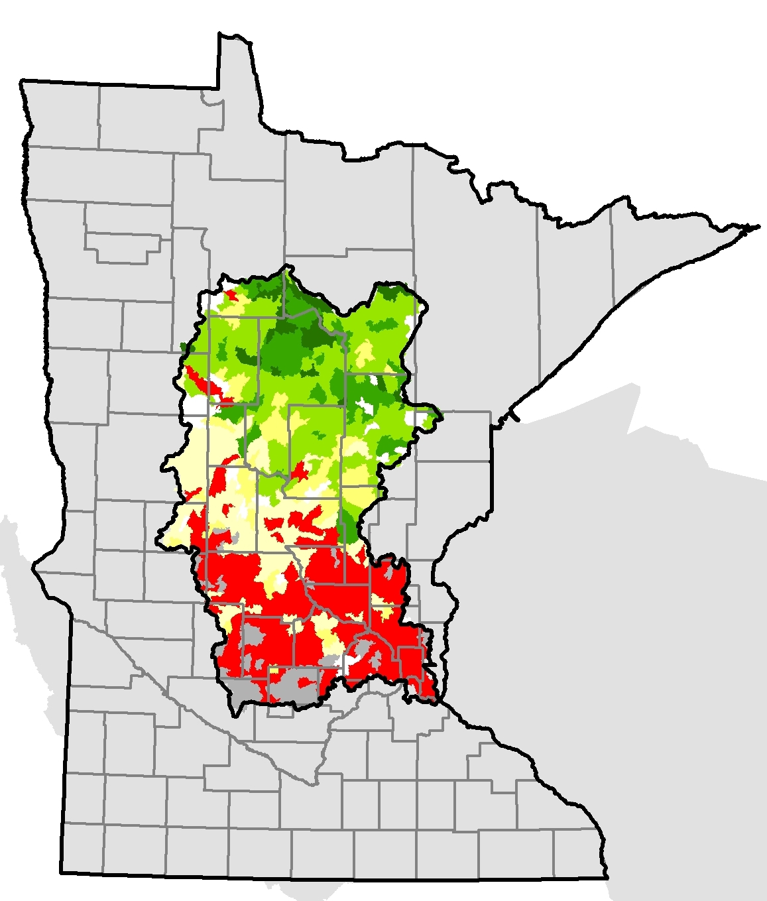
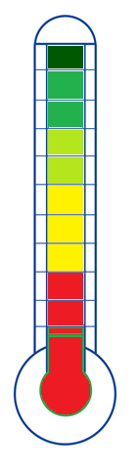
Getting to Scale
Secure
Good Enough?
Protection feasible
Cost effective improvements possible?
Impairment threshold
Notes:
It’s also important to be realistic in what we can do with the financial, technical and political resources we have. We may very well not be able to restore all degraded waters and to solely focus on those waters and watersheds that are severely impaired may not achieve success and will draw resources away from the watersheds that are barely impaired or face risk of impairment. Those are the value watersheds and places we can demonstrate success.

Slide 8
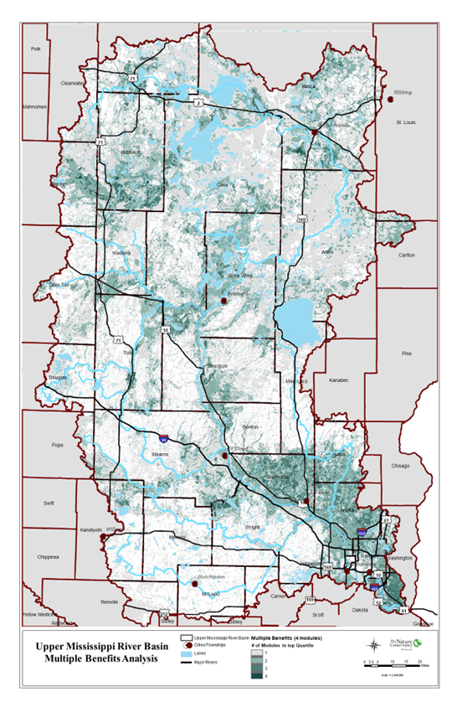
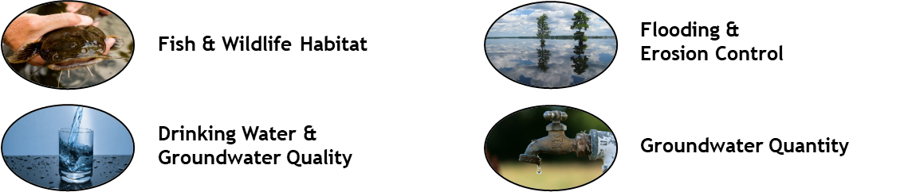
Mississippi Headwaters Priorities Restoration & protection for Multiple Benefits
Focus on parts of the landscape are most important for:
Notes:
TNC has been engaged in watershed plans and local watershed efforts for over 15 years. Our staff participated in the WRAPS and then the 1 Water 1 Plan processes, yet we found that our interests were not being heard by agencies. We didn’t think watersheds were setting priorities or reasonable outcomes. There was too much focus on impaired waters and a lack of public/private partnerships.
So we started to develop a series of tools and maps to try to get at those questions.
- What parts of the landscape are providing multiple benefits, for example : the following “watershed services”/benefits?
Biodiversity in terms of fish and wildlife , with a particular focus on aquatic systems such as coldwater fisheries, wild rice lakes
Clean water services: including drinking water, use, and amenity values such as recreation and water clarity
Water quantity – supply, storage, flood & drought mitigation for downstream water users (incl. municipal and industrial)

Slide 9
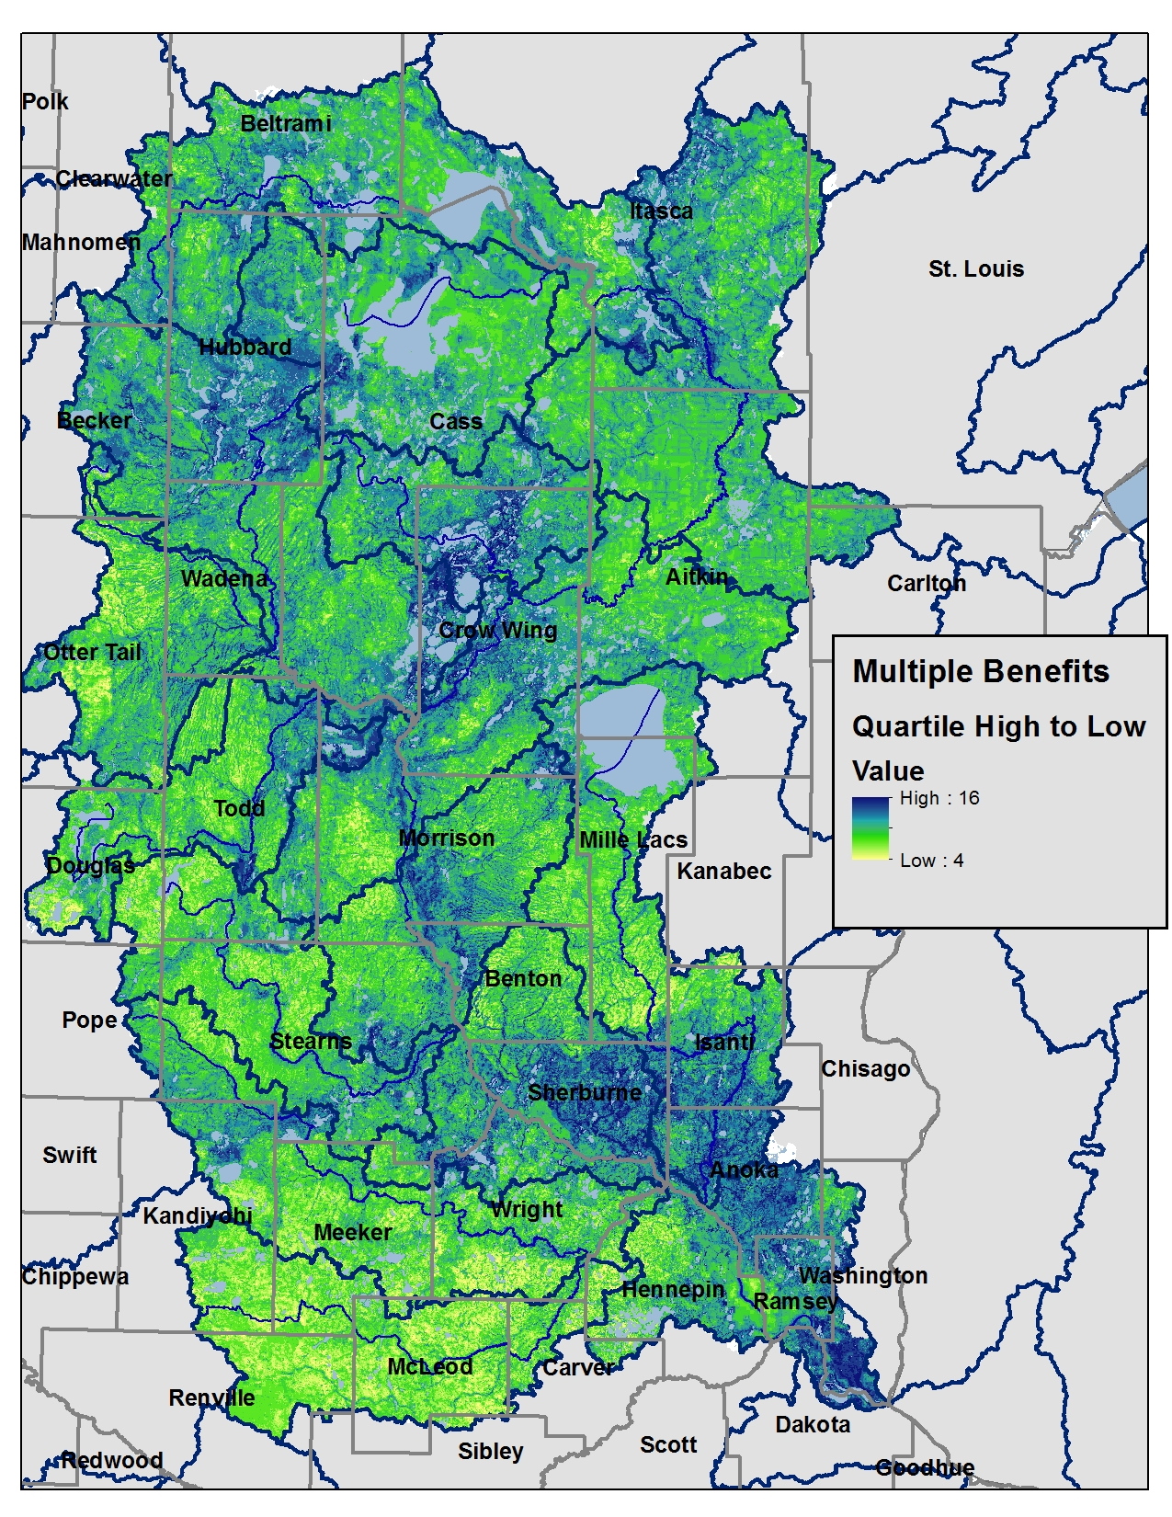
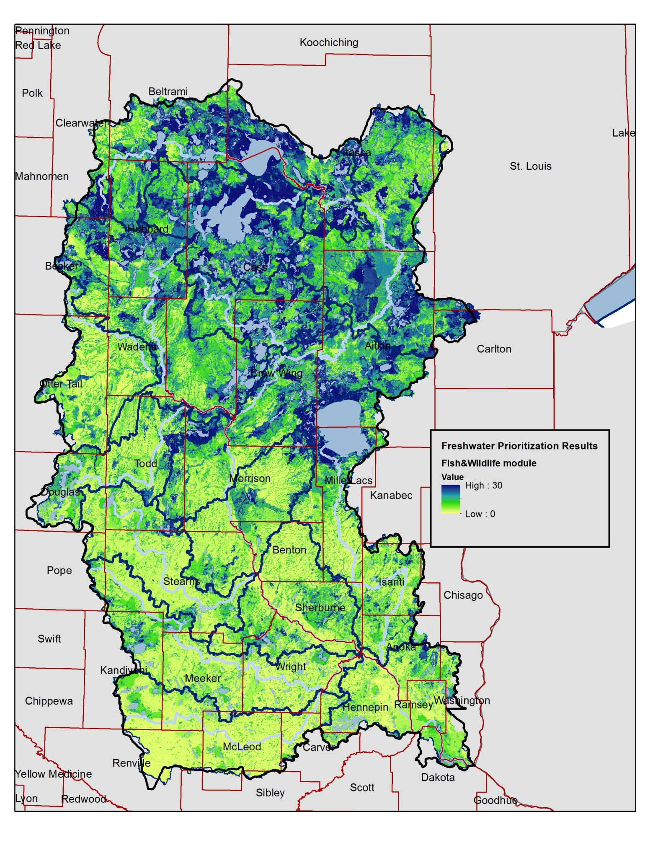
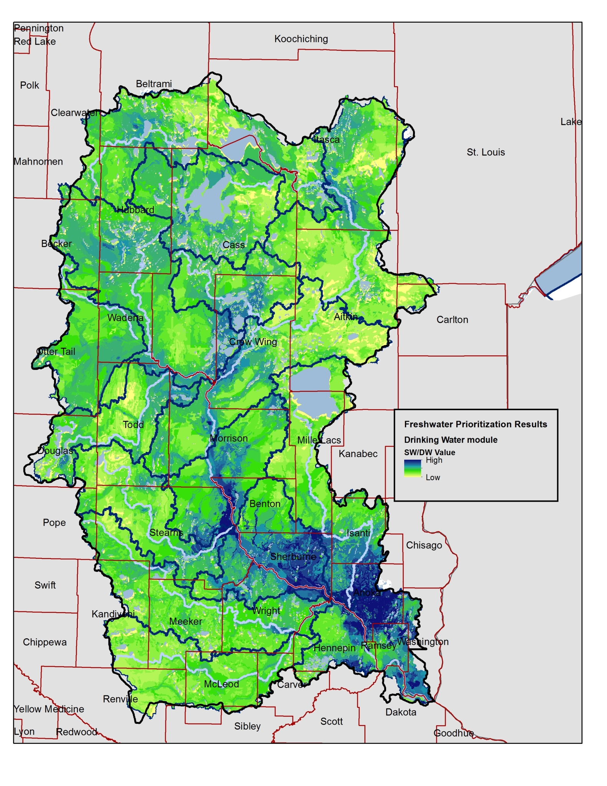
Mississippi Headwaters Freshwater Priorities Restoration & protection for Multiple Benefits
Prioritization “Modules”:
Aquatic Habitat /
Fish & Wildlife Value
Drinking Water / Groundwater
Flooding & Erosion
Shoreland
“Multiple Benefits”
+ =

Slide 10
Fish and Wildlife Module
Input layers:
RWI UMN-D benefits to species model
Biodiversity significance polygons
Lakes of biodiversity significance
High and highest IBI lakes
Wild rice catchments
Cisco refuge lake catchments
Forest protection value – FLEET
Proximity to water
Proximity to public lands (incl. STL)
Active River Area in perennial cover
Notes:
PROTECTION – AQUATIC Habitat / Fish & Wildlife Value (Module_fw.tif) : 30 pt RWI Restorable Wetlands Inventory benefit to species value(sppben100.tif - NRRI analysis 2014) Biodiversity significance score (MCBS outstanding/high/moderate polygons) 3 Lakes of biological significance [1-3 moderate to outstanding; if TNC portfolio lake but not LBS, score=1] IBI score (1-4 – level 8 catchments)
Coldwater refuge – cisco (use level 8 catchments)
Wild rice catchments (use level 8 catchments) High conservation value forest lands • Use FLEET for northern headwaters • Use USFWS UMR Priority Forest for Drinking Water score for southern half of the state/basin
Ecological patches or connections • Perennial x ARA (use for Mississippi headwaters) Proximity (inverse distance) to protected lands Proximity (inverse distance) to water

Slide 11
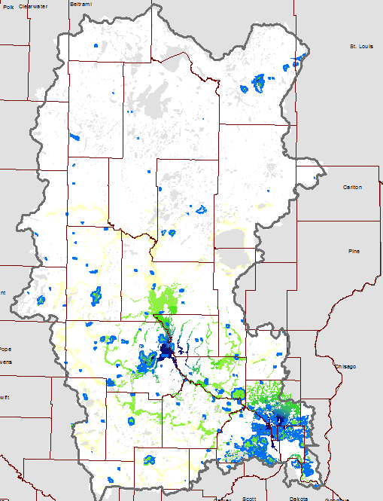
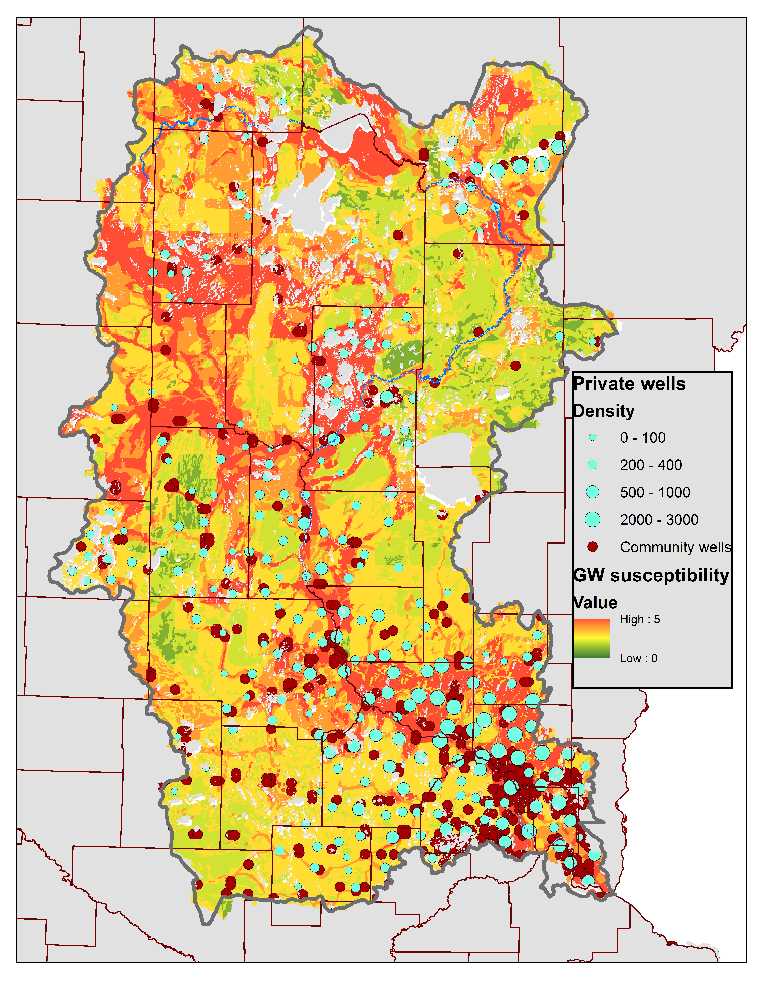
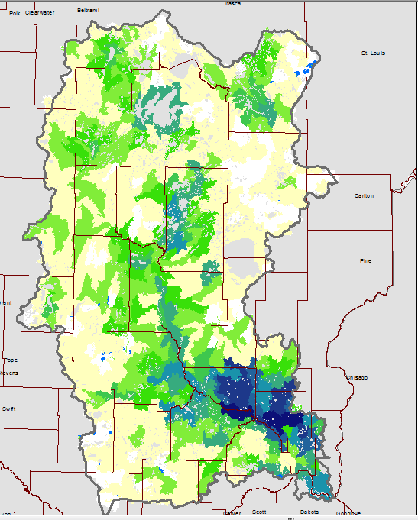

Protecting Drinking Water
Drinking water management supply area vulnerability / wellhead protection areas
Groundwater contamination susceptibility
Proximity to mainstem river water supply
Private well density
Notes:
Drinking Water Drinking water management supply area vulnerability / wellhead protection areas 8 Groundwater contamination susceptibility Proximity to mainstem river water supply (Mississippi River & major tribs) 8 Private well density (wellclass.tif) Groundwater recharge & supply (scaled 0-10) (Smith et al. 2015)

Slide 12
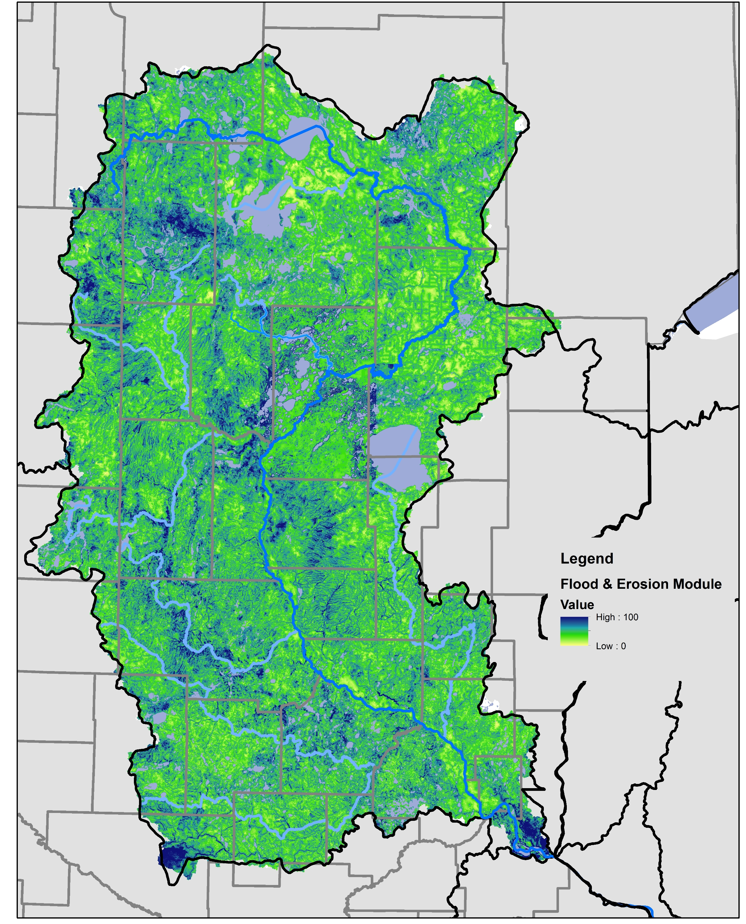
Reduce Flooding & Erosion
Benefits to water (UMD-RWP tool/BWSR Ecological Ranking Tool)
“patched” for counties lacking SSURGO
Sediment retention & storage benefits
InVEST Sedret x Perennial lands
InVEST Sedret x NWI
InVEST Sedret x ARA
Storage weighted by relative need
Ratio of watershed area / existing storage

Slide 13
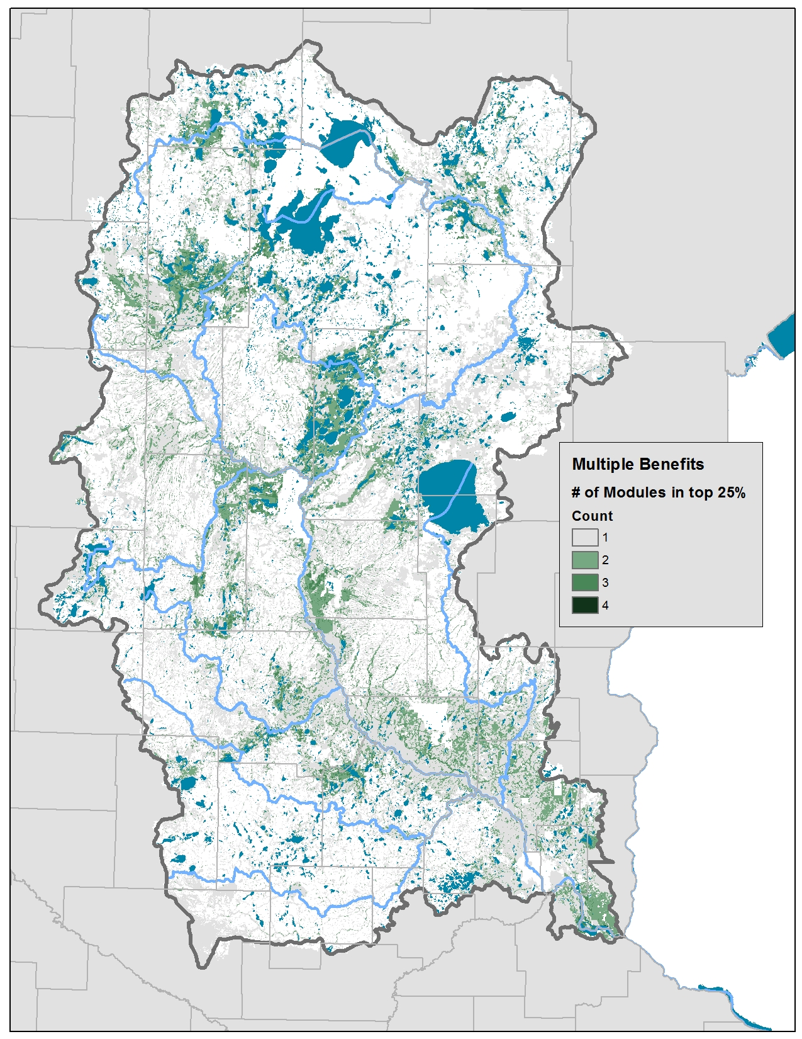
“Multiple benefits” ⬅ OR overlapping benefits:
Notes:
Bright Blue layers have the full statewide extent “Strategy” classification of watersheds based on : - 75% perennial protected land threshold - Location on water quality spectrum (impaired to high water quality) - Conversion risk (Ag & Development) - Trend (water quality, irrigation/water use, drainage, or other threats) - Importance to people (downstream users, economic/recreation/ecosystem service value, proximity to the Twin Cities users or community Drinking Water supply)
Noteworthy:
High scores for some already highly developed lands, e.g. metro areas, Rum: due to the Drinking water weights
High values in the BLA and large lakes because of shoreland
High values for Lake Alex, western Mille Lacs, Mississippi headwaters

Slide 14
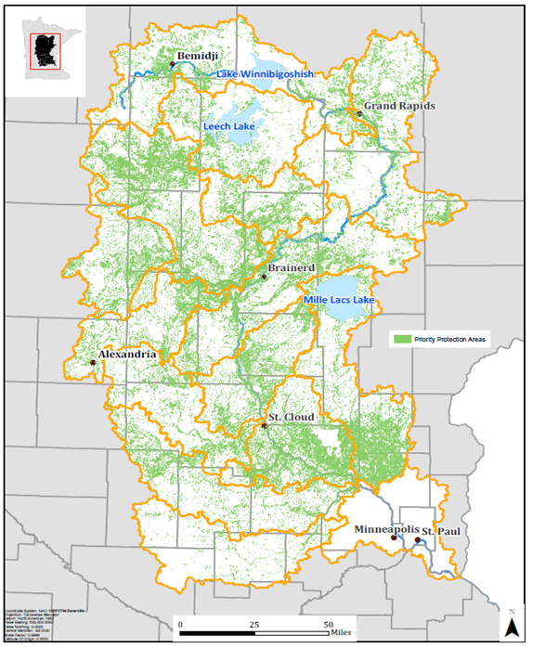
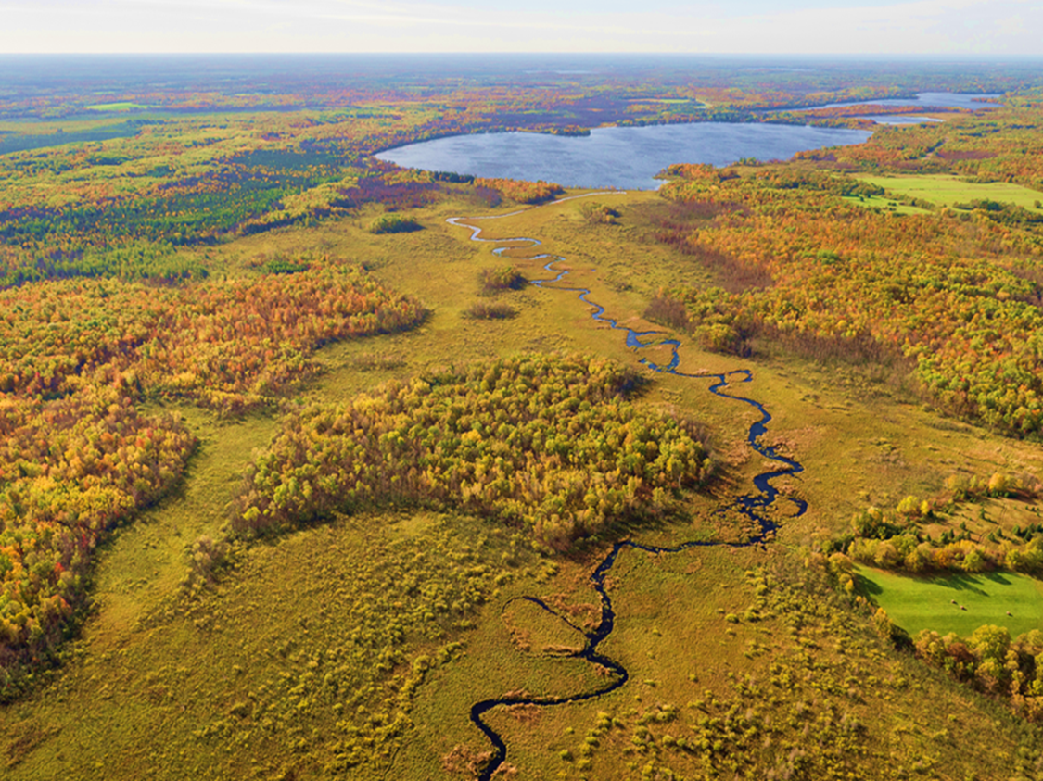
Protection Strategy Mapping
Notes:
protection and restoration will be accomplished in the key, targeted areas identified by the multiple benefit tool by finding a best fit program for the land and the landowner.
The Conservancy primarily works with local soil and water conservation districts to perform outreach to very specific landowners and offers technical assistance and program enrollment. We also do this on behalf of SWCDs when they have heavy workloads. We also regularly coordinate with state and local agencies in the area along with nongovernment partners interested in healthy waters protection. This allows us to use our collective resources efficiently.
This amounts to less than 1% of the basin.

Slide 15
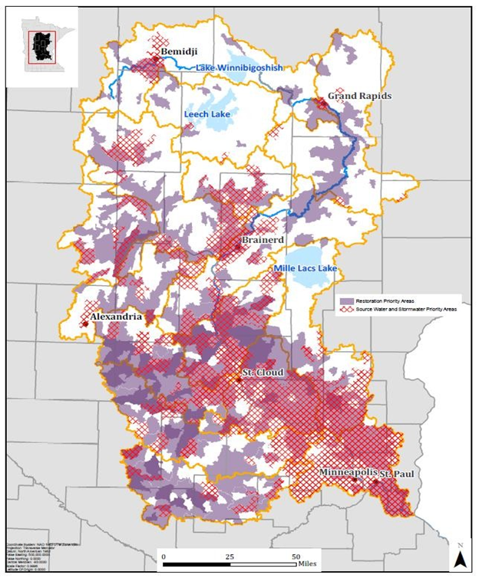
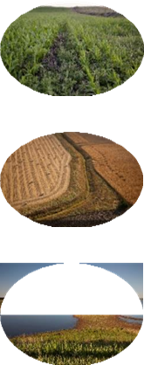
Maintaining, re-establishing, and mimicking natural watershed structure and function.
In-Field BMPS
Edge-of-Field BMPs
Downstream projects
Notes:
In field: such as cover crops, no- till, soil health practices, & promoting the “4Rs” for inputs (right source, right rate, right time, right place)
Edge-of-Field BMPs such as wetlands, WASCOBs, buffers, and 2-stage ditch projects that increase nutrient, sediment, & carbon retention, increase water storage, reduce flooding, decrease peak flows, & improve ground water recharge.
Downstream projects such as river channel restoration & floodplain reconnection projects that restore aquatic habitat, floodplain function, & reduce instream nutrient & sediment sources.

Slide 16
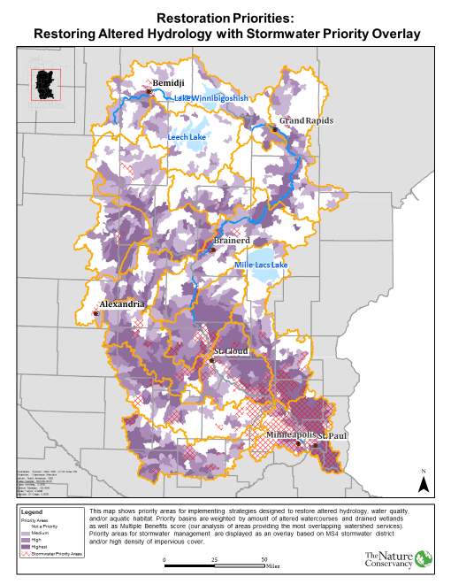
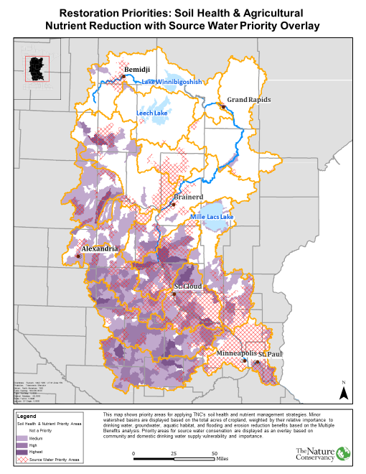

Slide 17
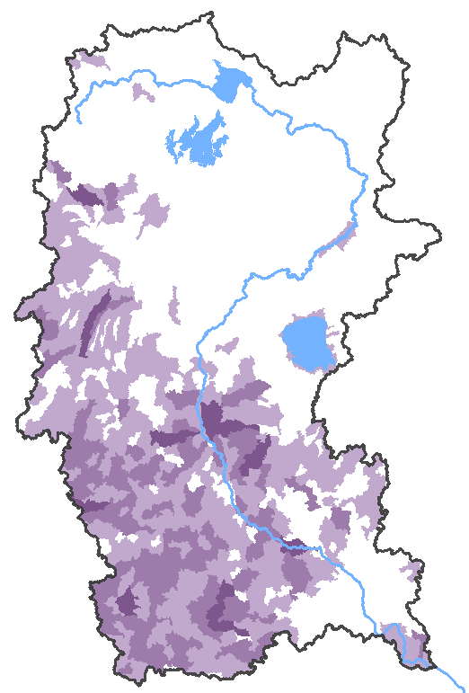
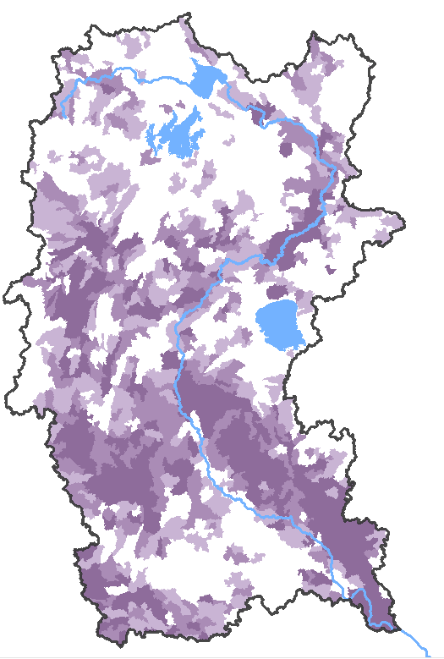
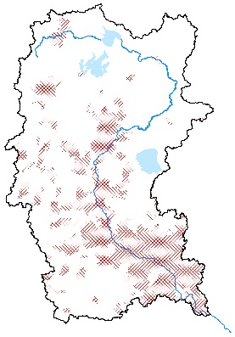
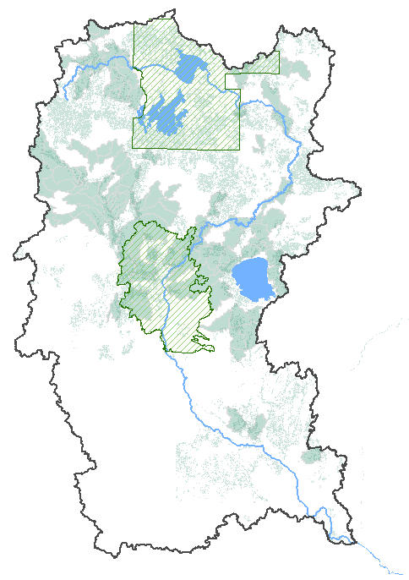
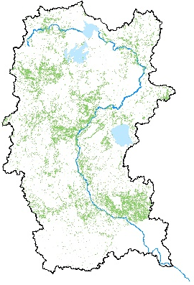
Restoration
Protection
1. General Advice & Assistance
2. Specific Advice & Assistance
3. Grants/ Cost-Share Projects
4. Land Use Controls
5. Incentive Programs to Enroll Land
6. Donated & purchased land interest
Nutrient management & soil health
Edge-of-field restoration of altered hydrology & water quality, riparian buffers, perennial filter strips, wetland/stream restoration
Source water/drinking water strategies
Cover crops, stormwater practices & strategies
Private forest stewardship plans, Sustainable Forest Incentive Act (SFIA)
Conservation easements & fee title acquisition
Notes:
When we talk about protection, TNC is focusing on working forest easements, this allows for land to remain in private ownership and continue to be managed for forest products, but prevents further fragmentation or development. We also promote the use of tax incentives. Of the larger basin, our goal is to protect less than 1%.

Slide 18
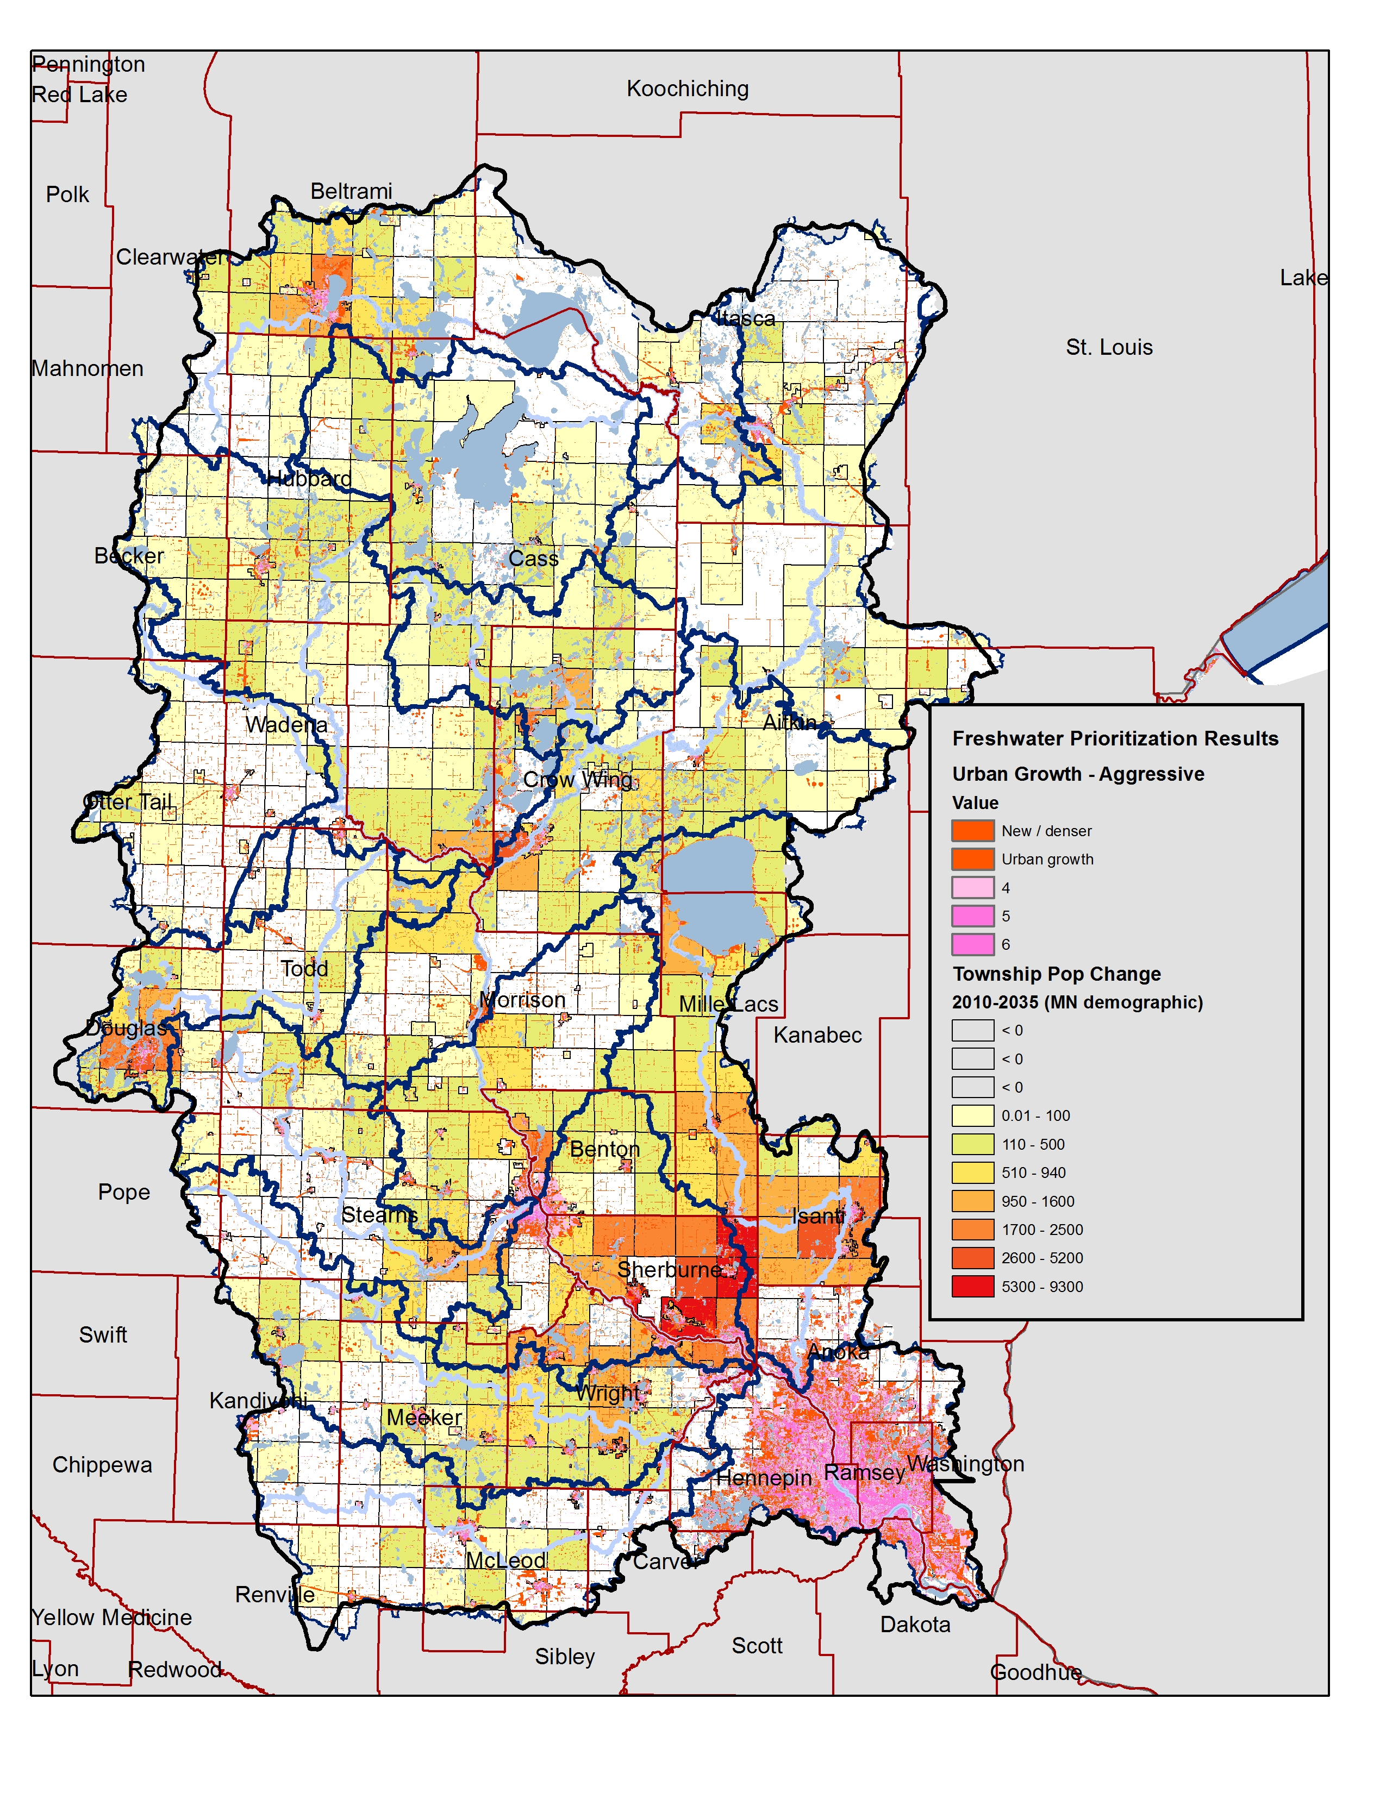
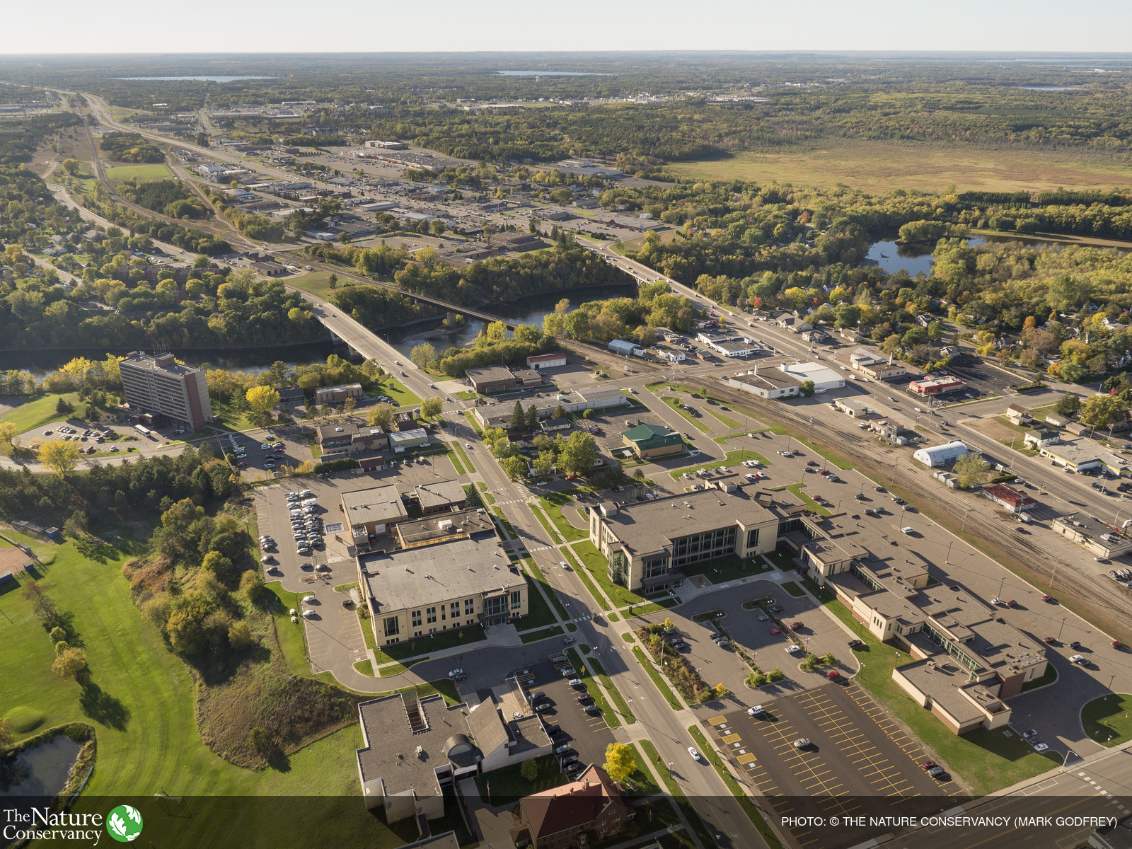
Threats & Trends: Growth & development
Notes:
Population / township growth projections (MN Demographic office)
“Worst case” urban growth scenario.
Combines-
Pijanowski Land Use Model, Purdue (used by P. Jacobson)
Theobald Housing Density Projections

Slide 19
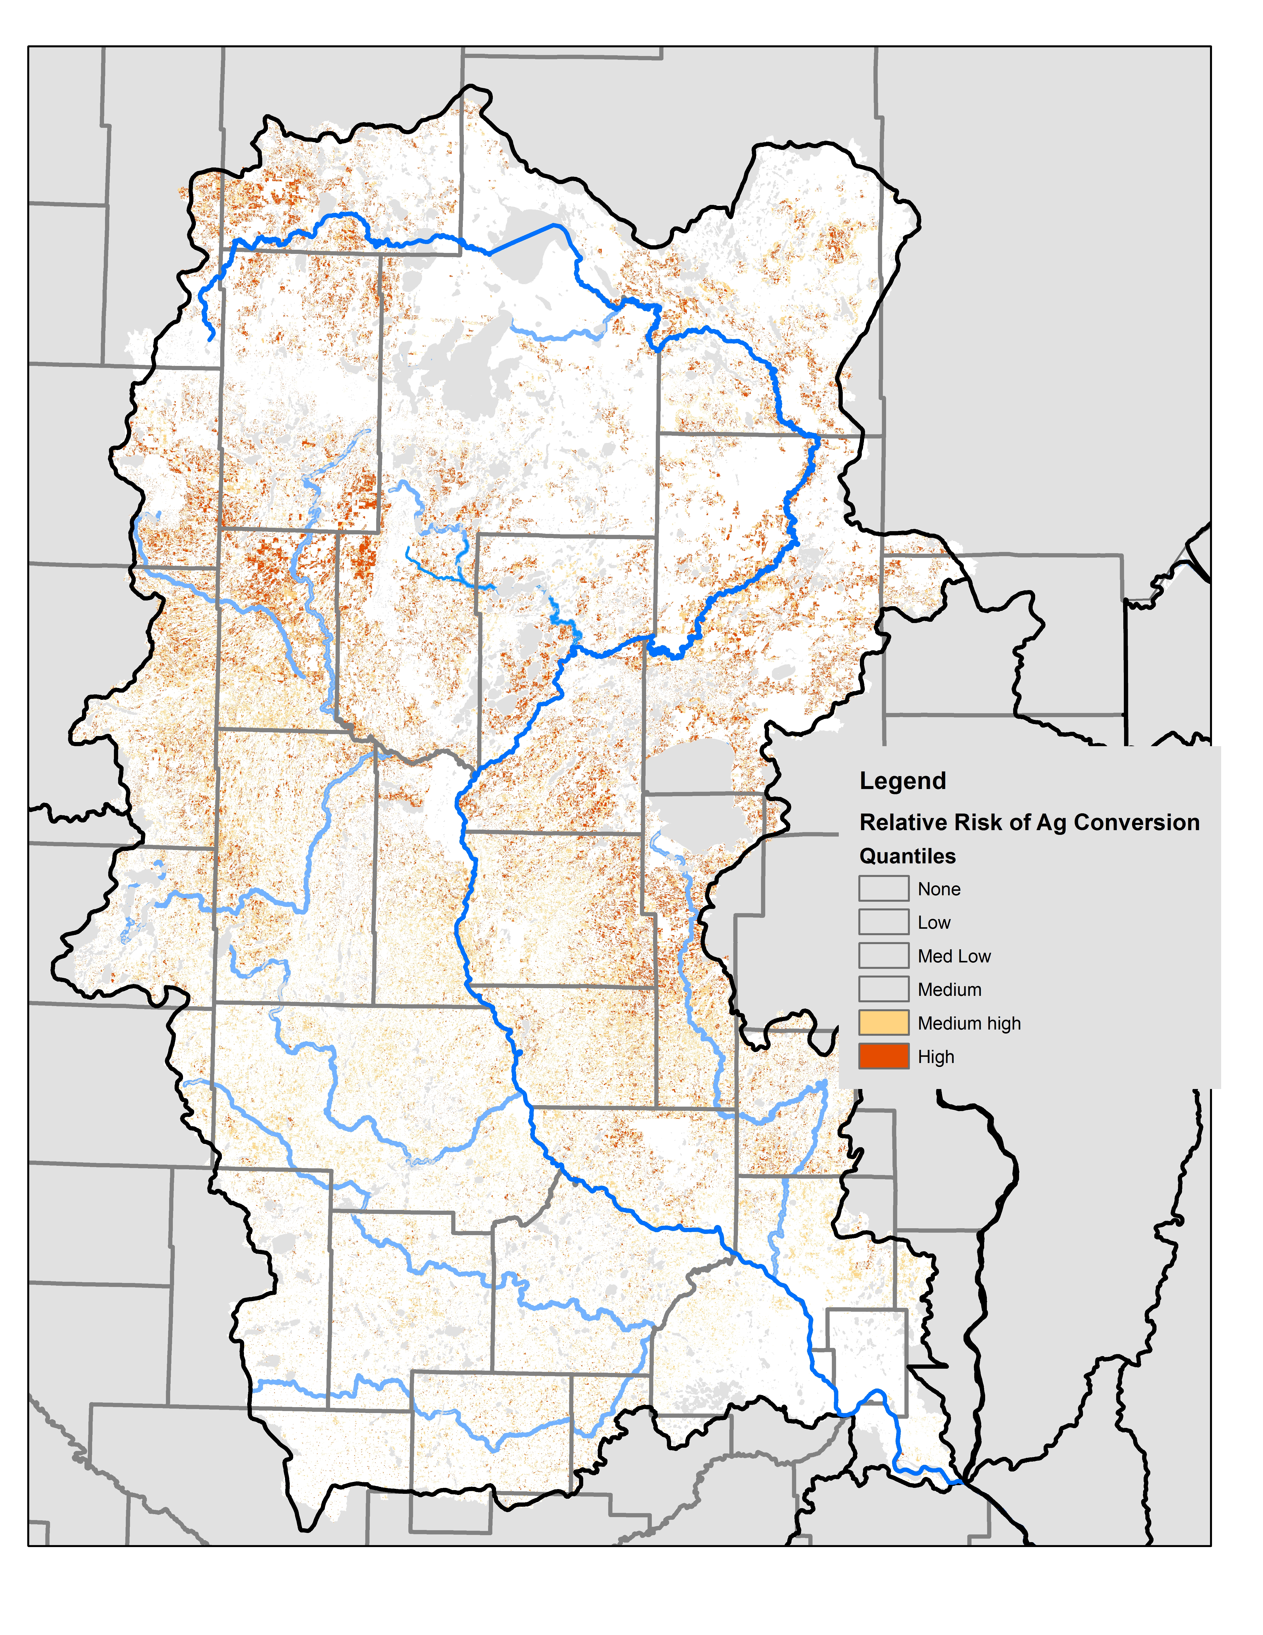
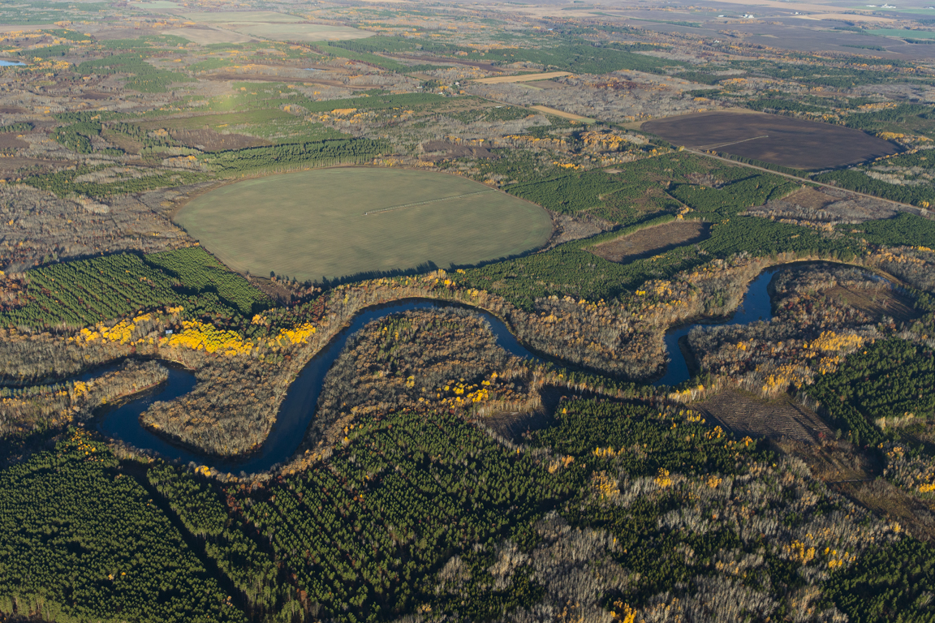
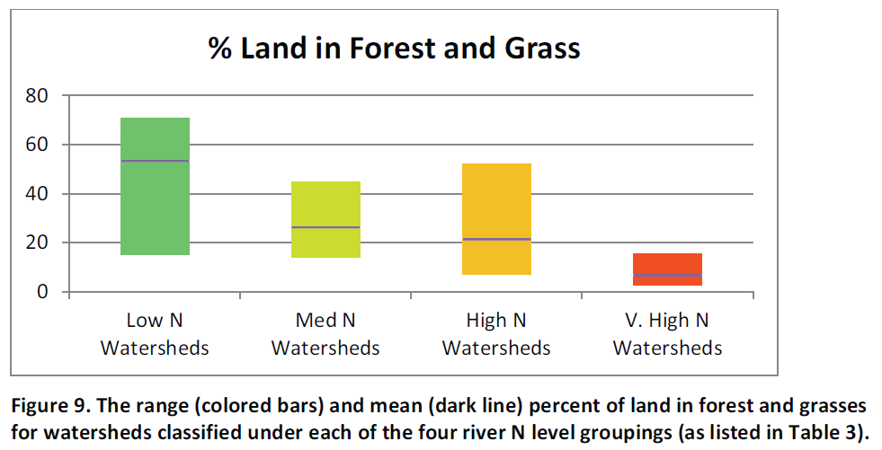
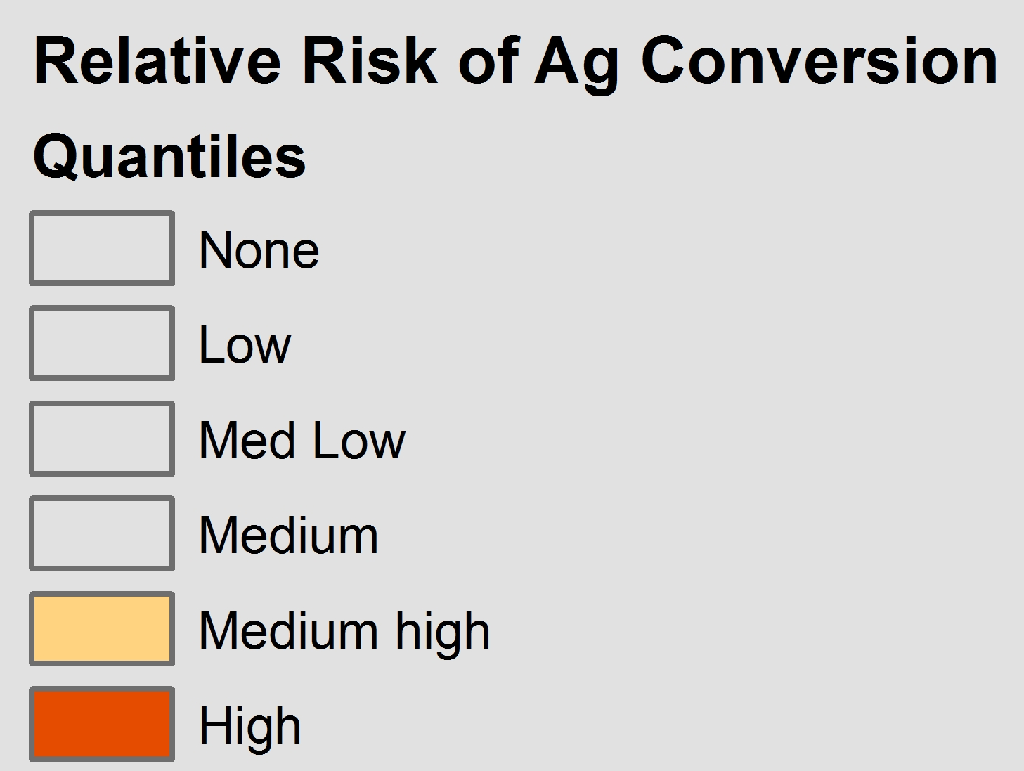
Relative risk of conversion to cropland
Notes:
It’s not enough to react to past land conversion, we must take proactive measures to ensure critical watershed features are not converted, causing ir-repairable damage to water resources, as we’ve seen in Southern MN, Iowa and much of the “Corn belt”.
We know that as more forest and grass is converted to row cropland, nutrient to surface and groundwater increases.
We need to understand the other risk factors of conversion and provide alternatives.
More corn, less fish, less clean water…increased cost of water.
Risk Factors
Low slope
Privately owned parcels
> 30 acre parcel size
% soil type already in row crop
Proximity to existing row crop land use & roads
Not wetland
Not urban

Slide 20
Programs That Support Watershed Health
Forests for the Future
Working Grasslands
Reforestation for Resilience
Dam Modification
Water Storage
Floodplain Restoration
Notes:
these are some of the programs we know will achieve outcomes, but it is also not an exhaustive list. Some are eligible for Clean Water Funds, all are eligible for bonding and several have been traditionally funded by bonding

Slide 21
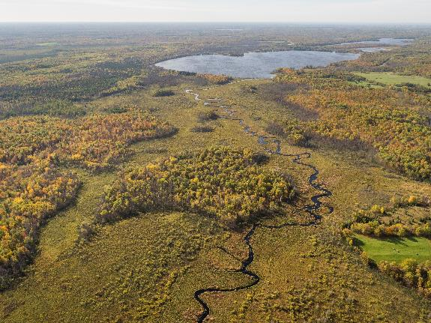
Questions
Rich Biske
Freshwater Program Director
rbiske@tnc.org
(612) 331-0766
Notes:
The Nature Conservancy is committed to protecting healthy watersheds and is currently trying to raise $10M of private funds to work with and invest with the State of MN funds for the protection of the Mississippi River.

